Slide 1

CSE- 322
Software Engineering Lab
Lab : 01 Overview
Fahad Ahmed
Lecturer, Dept. of CSE
E-mail: fahadahmed@uap-bd.edu

Slide 2
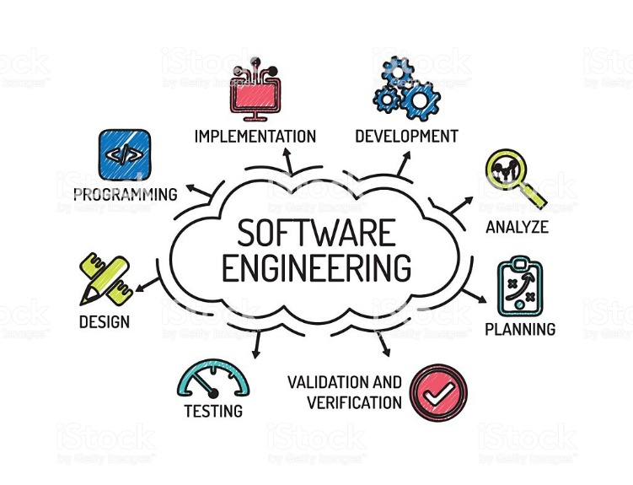

Slide 3
Marks Distribution
Class Performance/ Continuous Evaluation + Viva | 30%
Final (Project) + Viva | 70%
Total | 100%

Slide 4
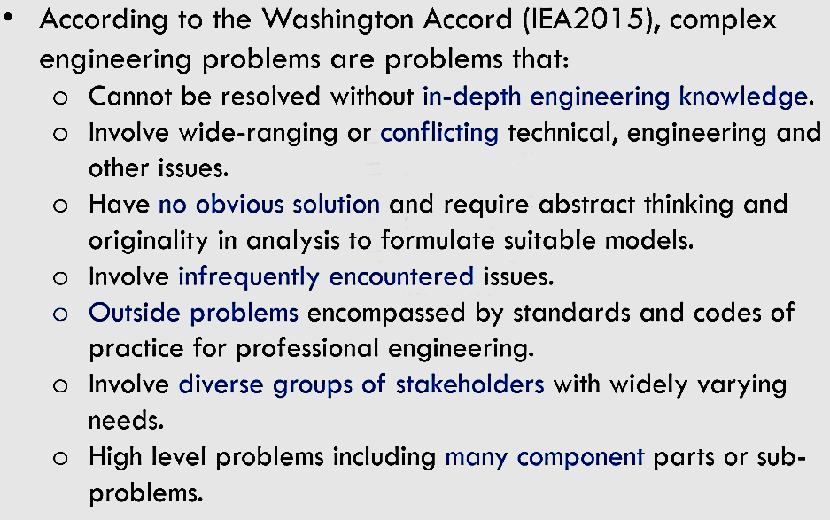
Complex Engineering Problems
How to Demonstrate through Projects?

Slide 5
Project Report
Project Management : Role of members (Team lead, member, etc)
Project: problem analysis + SRS+ UML
Investigation : Literature Review
The Engineer and society : Effect on Society
Environment and sustainability: Effect on environment and is it sustainable?
Ethics: manual code review +Turnitin plagiarism checker (Max 25%)
Individual work and team work: Version Control System + project problem solution (stack over flow, Quora,etc)
Project management and finance: according to software cost model
Coding/ Design pattern: are you following (sample code)
Testing: Are you using? How?
Demo: live in lab (Project Presentation)
A table of mapping among Ps, Ks, A of Complex engineering problem
In Future, some points will be added

Slide 6
Marks Distribution (Proposed)
1 | Design/development of solutions + Ethics | 20
2 | Testing | 5
3 | Design pattern | 5
4 | Modern tool usage | 5
5 | Problem Definition + Literature Review + SRS + Intro+ UML+ Etc. | 5
6 | The Engineer and society | 5
7 | Environment and sustainability | 5
8 | Individual work and team work + Communication | 5
9 | Project management and finance | 5
10 | Life-long learning | 5
11 | Mapping | 5
 | Total | 70

Slide 7
Consultancy
Contract Number: 01737777912
(9.00 am- 7.00 pm)
Email: fahadahmed@uap-bd.edu

Slide 8
Next Lab
Make a Team(3 members)
Prepare a presentation
Provide a google doc link of report.
Project Management : Role of members (Team lead, member, etc)
Project: problem analysis + UML+ Etc. [SRS]
Investigation : Literature Review
The Engineer and society : Effect on Society
Environment and sustainability: Effect on environment and is it sustainable?

Slide 9
Project Idea
This are not complex engineering problem (CEP), try to make it into CEP
https://nevonprojects.com/year-projects-for-computer-engineering/
https://1000projects.org/

Slide 10
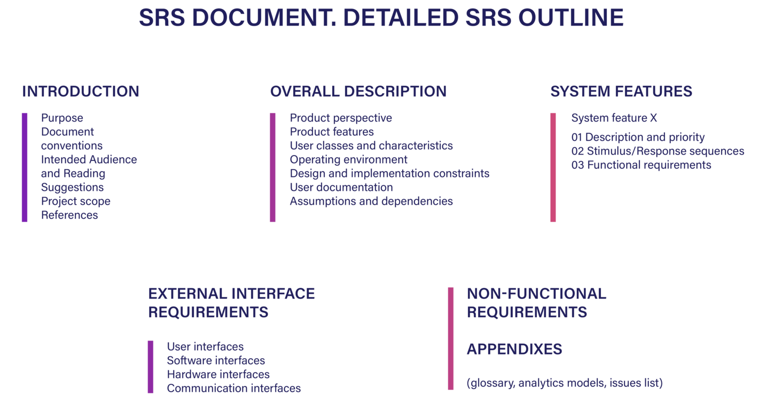
SRS

Slide 11

Thanks to All

